Slide 1
Unit III

Slide 2
Unsupervised Pretrained Networks
Autoencoders
Deep Belief Networks (DBNs)
Generative Adversarial Networks (GANs)

Slide 3
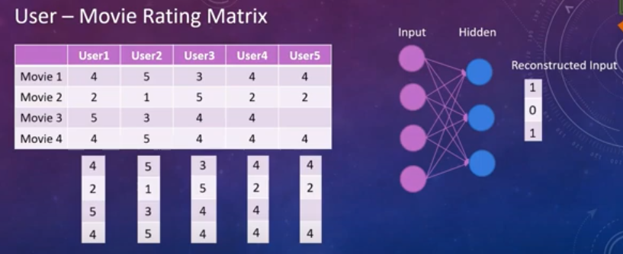
RBM
User 5 so far not yet watched the movie 3. ( all the users data will be send in vector form eg user1 4,2,5,4 will be send to through input layer and after some processing , it gives a vector form with 1,0,1 I hidden layer) while sending the user5 data, it checks for matching interest from other user, it gets matched with user4 and user1. user1 as 5 and user4 as 4, from this we can guess that the movie is liked by the user.
Based on the reconstructed input, user 5 is interested to watch movie 3 and recommend it.(bex similar taste of interest by user1 and user4)
This is called collabrative filtering, a type of recommender system.
Taking the given input and based on that its reconstructing a value
Such model is called restricted Boltzmann machines.
Two things we can understand from this:
Here only two layers getting involved .
Its not finding anything new, instead its reconstructing the input and giving a new one

Slide 4
RBM are shallow neural networks with only two layers.
Automatically finds patterns in data by reconstructing the input.
Extract important features and reconstruct input.
Combine features to form patterns (eg from rating, we can find like or dislike, as like that from others features, we can find someother things)
Unlabelled data(real-world data)
Photos
Videos
Voices
Sensor data
First layer is called as visible layer
Second layer is hidden layer
Why ‘restricted’ bez neurons within the same layer are not connected only connection between two layers (this is the first model so that they have told as restricted)
With unlabelled data, it can reconstruct the input data.
RBM can be used at, where we can able to find or extract the feature set from the given data

Slide 5
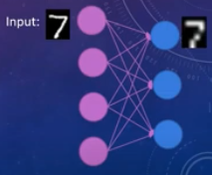
Feeding the input data, the network learns its weight(associated in input layer).
Feeding an input image, the values that appear in the hidden layer can be considered as features learnt automatically from the input data.
There are a smaller number of units in the hidden units of an RBM(so blurred)
Good representation of data that are lower in dimensionality (compared to original data)
In matrix form, respective rows and columns which says that as 7 are considered as features and reconstructed as blurred 7.
Useful in applications of:
Dimensionality reduction
Feature extraction
Collaborative filtering
It’s a part of input reconstruction
Other kind of models called deep belief networks or deep neural networks

Slide 6
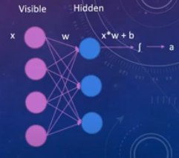
Each visible node takes a low level feature from an item in the dataset to be learned.
At node 1 of the hidden layer, x is multiplied by a weight and added to a bias.
The result of those two operations is fed into an activation function.
This produces the node’s output, or the strength of the signal (feature)passing through it. If strength of the signal is strong, then it can be used for reconstruction.
The learning process consists of several forward and backward passes.
Forward pass: image to vectors(called encoding)
Backward pass: vectors to image
The weights of the neural network are adjusted in such a way That:
The RBM can find the relationship among input features and then
Determines which features are relevant.( other are unnecessary)

Slide 7
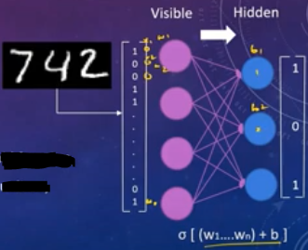
Training RBM : 3 steps
Forward pass:
Input image converted to binary values(vector)
Then input vector is fed into the net
Its values are multiplied by weights and an overall bias is added.(in hidden layer)
Then, the result goes to an activation function such as a sigmoid function.
This represents the probability of turning each individual hidden-unit on, or in other words, the probability of the node activation.
The 3 units in hidden layer, with 1,0,1. here, 1(on) will be taken for reconstruction and 0 (OFF) will not be considered for reconstruction
Then, a sample is drawn from the probability distribution.
Forward pass translate the input data into binary values that gets represented in hidden layer

Slide 8
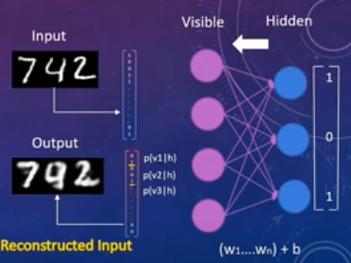
Backward pass:
Data passed backwards
Also combined with same weights and overall bias(used in forward pass)
Once the info gets to the visible layer, it is in the shape of probability distribution of the input values.
Sampling the distribution, the input is reconstructed.
The activated neurons in the hidden layer send the results back to the visible layer where the input will be reconstructed.
Backward pass is about making guesses about the probability distribution of the original input

Slide 9
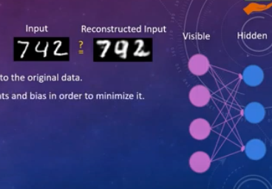
Assessing the reconstruction Quality:
Assessing the quality of the reconstruction by comparing it to the original data.
RBM then calculates the error and adjusts the weights and bias in order to minimize it.
In each epoch,
We compute the error as a sum of the squared difference between step 1 and the next step
These 3 steps are repeated until the error is found sufficiently low.
Epoch: when an entire dataset is passed forward and backward through the neural network only once.

Slide 10
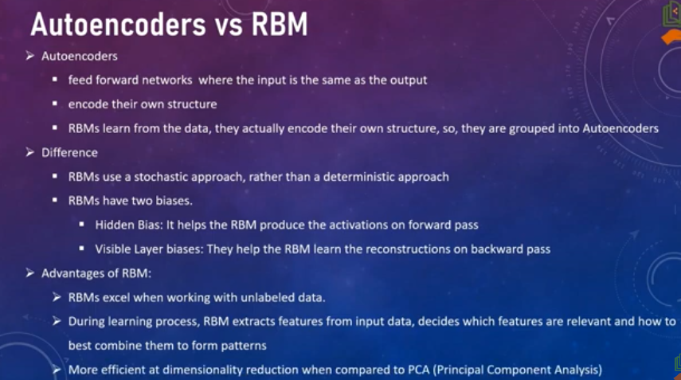

Slide 11
DBN
DBNs are composed of multiple layers of stochastic, or randomly determined, units. These units are known as Restricted Boltzmann Machines (RBMs) or other similar structures. Each layer in a DBN aims to extract different features from the input data, with lower layers identifying basic patterns and higher layers recognizing more abstract concepts.
This structure allows DBNs to effectively learn complex representations of data, which makes them particularly useful for tasks like image and speech recognition, where the input data is high-dimensional and requires a deep level of understanding.
The architecture of DBNs also makes them good at unsupervised learning, where the goal is to understand and label input data without explicit guidance. This characteristic is particularly useful in scenarios where labelled data is scarce or when the goal is to explore the structure of the data without any preconceived labels.

Slide 12
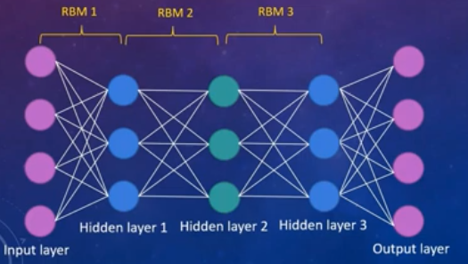
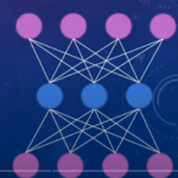
DBN – Deep Belief Networks
Alternative to backpropagation (feed forwards training alg)
DBN is identical to an MLP in netowrk structure.
It can be viewed as a stack of RBMs, where the hidden layer of one RBM is the visible layer of the one “above” it.
First RBM with Visible and hidden layers, then later, hidden of first RBM becomes visible and next layer becomes hidden(green)

Slide 13
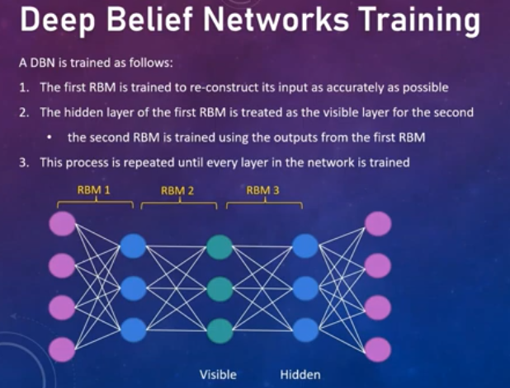
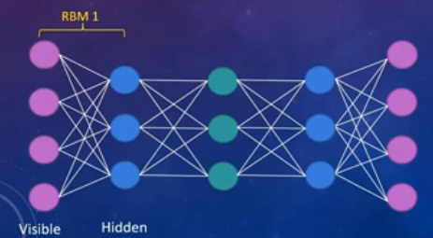
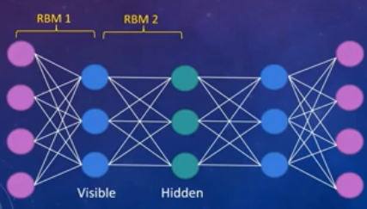

Slide 14
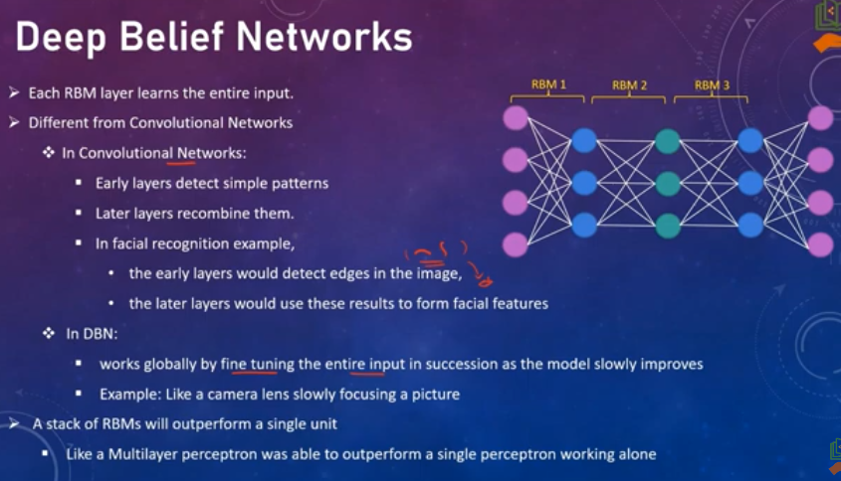

Slide 15
Feed forward NN with Deep architecture
Less computational costly
Several layers of latent(hidden) variables make a DBN
The training process can be completed in a reasonable amount of time through the use of GPU’s
Training session involves training from bottom layer.
Greedy algorithm trains one RBM at a time until all of the RBMs are trained.
Top layer will use the class labels to classify unknown data in case of classification DBN.
Training time for one RBM is more than the whole DBN training
Result will be very accurate in DBN compared to a shallow net(RBN)

Slide 16
How Deep Belief Networks Work?
DBNs work in two main phases: pre-training(feature Extraction) and fine-tuning.
In the pre-training phase, the network learns to represent the input data layer by layer. Each layer is trained independently as an RBM, which allows the network to learn complex data representations efficiently. During this phase, the network learns the probability distribution of the inputs, which helps it understand the underlying structure of the data.
In the fine-tuning phase, the DBN adjusts its parameters for a specific task, like classification or regression. we use normal backpropagation with a lower learning rate to do “gentle” backpropagation.This is typically done using a technique known as backpropagation, where the network’s performance on a task is evaluated, and the errors are used to update the network’s parameters. This phase often involves supervised learning, where the network is trained with labelled data.
The output layer. The normal goal of a deep network is to learn a set of features. The first layer of a deep network learns how to reconstruct the original dataset. The subsequent layers learn how to reconstruct the probability distributions of the activations of the previous layer. The output layer of a neural network is tied to the overall objective. This is typically logistic regression, with the number of features equal to the number of inputs of the final layer, and the number of outputs equal to the number of classes.

Slide 17
Concepts Related to Deep Belief Networks (DBNs)
Restricted Boltzmann Machines (RBMs): These are the building blocks of DBNs. An RBM is a two-layered neural network that learns the probability distribution of the input data. Each layer in a DBN is typically an RBM.
Stochastic Units: DBNs use units that make decisions probabilistically. This stochastic nature allows the network to explore and learn more complex patterns in the data.
Layer-wise Training: DBNs are trained one layer at a time, which is efficient and helps in learning deep representations of data.
Unsupervised and Supervised Learning: DBNs are versatile, capable of both unsupervised learning (learning from unlabeled data) and supervised learning (learning from labeled data).
Greedy Algorithm: This is used during the pre-training phase of DBNs. Each layer is trained greedily, meaning it’s trained independently of the others, which simplifies the training process.
Backpropagation: In the fine-tuning phase, backpropagation is used for supervised learning tasks. It adjusts the network’s parameters to improve its performance on specific tasks.

Slide 18
Convolutional Neural Networks (CNNs)
is a type of Deep Learning neural network architecture commonly used in Computer Vision. Computer vision is a field of Artificial Intelligence that enables a computer to understand and interpret the image or visual data.
Different types of Neural Networks are used for different purposes, for example for predicting the sequence of words , use Recurrent Neural Networks more precisely an LSTM, similarly for image classification we use Convolution Neural networks.
In a regular Neural Network there are three types of layers:
Input Layers: It’s the layer in which we give input to our model. The number of neurons in this layer is equal to the total number of features in our data (number of pixels in the case of an image).
Hidden Layer: The input from the Input layer is then fed into the hidden layer. There can be many hidden layers depending on our model and data size. Each hidden layer can have different numbers of neurons which are generally greater than the number of features. The output from each layer is computed by matrix multiplication of the output of the previous layer with learnable weights of that layer and then by the addition of learnable biases followed by activation function which makes the network nonlinear.
Output Layer: The output from the hidden layer is then fed into a logistic function like sigmoid or softmax which converts the output of each class into the probability score of each class.
The data is fed into the model and output from each layer is obtained from the above step is called feedforward, we then calculate the error using an error function, some common error functions are cross-entropy, square loss error, etc.After that, we backpropagate into the model by calculating the derivatives. This step is called Backpropagation which basically is used to minimize the loss.

Slide 19
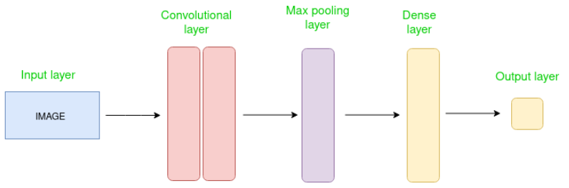
CNN architecture
Convolutional Neural Network consists of multiple layers like the input layer, Convolutional layer, Pooling layer, and fully connected layers.
The Convolutional layer applies filters to the input image to extract features, the Pooling layer downsamples the image to reduce computation, and the fully connected layer makes the final prediction. The network learns the optimal filters through backpropagation and gradient descent.
A complete Convolution Neural Networks architecture is also known as CNN or convnets.
Professor Yann LeCunn of Bell Labs created the first successful convolution networks in the late 1990s.

Slide 20
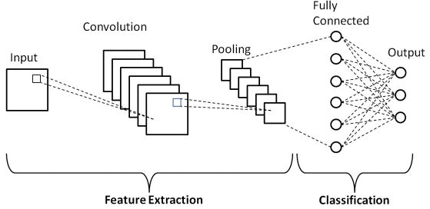
Basics of CNN Architecture
There are two main parts to a CNN architecture
A convolution tool that separates and identifies the various features of the image for analysis in a process called as Feature Extraction.
The network of feature extraction consists of many pairs of convolutional or pooling layers.
A fully connected layer that utilizes the output from the convolution process and predicts the class of the image (classification) based on the features extracted in previous stages.
This CNN model of feature extraction aims to reduce the number of features present in a dataset. It creates new features which summarises the existing features contained in an original set of features. There are many CNN layers as shown in the basic CNN architecture with diagram.

Slide 21
How Are CNN Used Image Classification?
CNNs excel in this task because they can automatically extract meaningful spatial features from images. Here are different layers involved in the process:
Input Layer : The input layer of a CNN takes in the raw image data as input. The images are typically represented as matrices of pixel values. The dimensions of the input layer correspond to the size of the input images (e.g., height, width, and color channels).
Convolutional Layers : Convolutional layers are responsible for feature extraction. Filters (also known as kernels) convolve with the input images to capture relevant patterns and features(learn to detect edges, textures, shapes,and other important visual elements. Convolution is a mathematical operation that allows the merging of two sets of information
Pooling Layers : to reduce the spatial dimensions of the feature maps produced by the convolutional layers. They perform downsampling/subsampling operations (e.g., max pooling) to retain the most salient information while discarding unnecessary details.
Fully Connected Layers : One or more fully connected layers flatten the output of the last pooling layer and connect to it. These layers function as traditional neural network layers and classify the extracted features. The fully connected layers learn complex relationships between features and output class probabilities or predictions.
Output Layer :The output layer represents the final layer of the CNN algorithm steps. Additionally, it consists of neurons equal to the number of distinct classes in the classification task. This layer provides each class’s classification probabilities or predictions. Consequently, it indicates the likelihood of the input image belonging to a particular class.

Slide 22
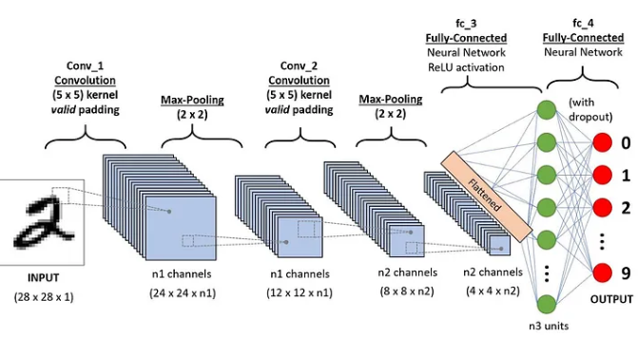
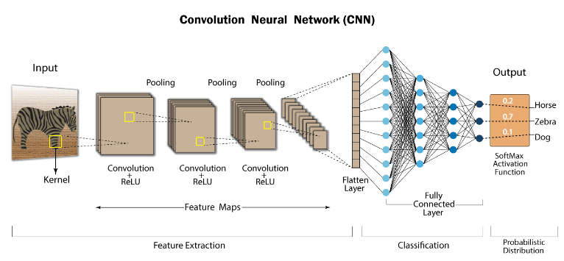

Slide 23
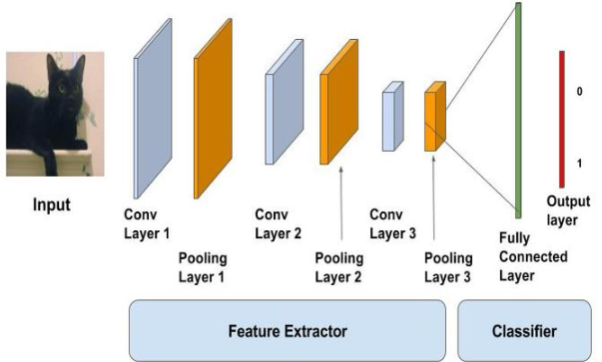

Slide 24
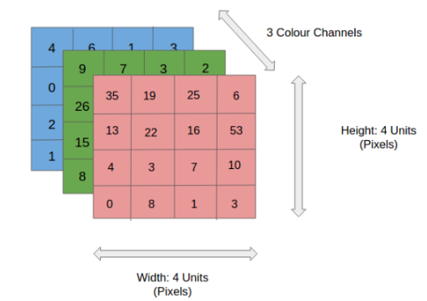
Input layer
Our input image and can be Grayscale or RGB. Every image is made up of pixels that range from 0 to 255. We need to normalize them i.e convert the range between 0 to 1 before passing it to the model.
Below is the example of an input image of size 4*4 and has 3 channels i.e RGB and pixel values.

Slide 25
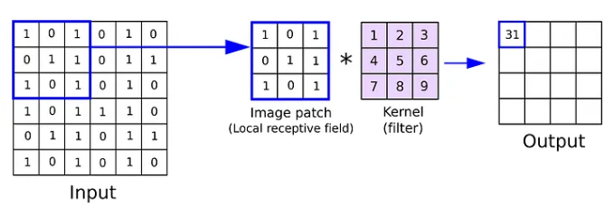
Kernel or Filter or Feature Detectors
In a convolutional neural network, the kernel is a filter that is used to extract the features from the images.
Formula = [i-k]+1
i -> Size of input , K-> Size of kernel
Feature Map = Input Image x Feature Detector

Slide 26
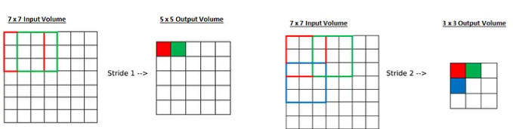
Stride
Stride is a parameter of the neural network’s filter that modifies the amount of movement over the image or video. we had stride 1 so it will take one by one. If we give stride 2 then it will take value by skipping the next 2 pixels.
Formula =[i-k/s]+1
i -> Size of input , K-> Size of kernel, S-> Stride

Slide 27
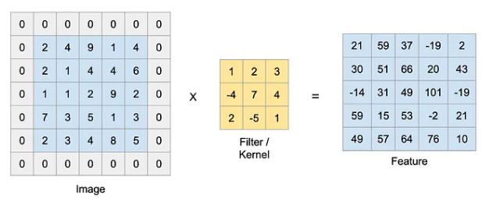
Padding
Padding is a term relevant to convolutional neural networks as it refers to the number of pixels added to an image when it is being processed by the kernel of a CNN. For example, if the padding in a CNN is set to zero, then every pixel value that is added will be of value zero. When we use the filter or Kernel to scan the image, the size of the image will go smaller. We have to avoid that because we want to preserve the original size of the image to extract some low-level features. Therefore, we will add some extra pixels outside the image.
Formula =[i-k+2p/s]+1
i -> Size of input , K-> Size of kernel, S-> Stride, p->Padding

Slide 28
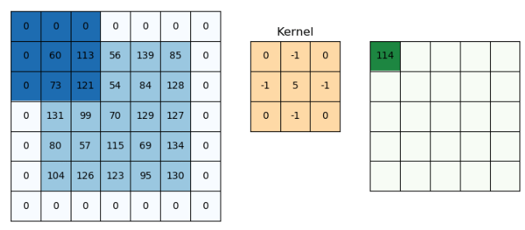
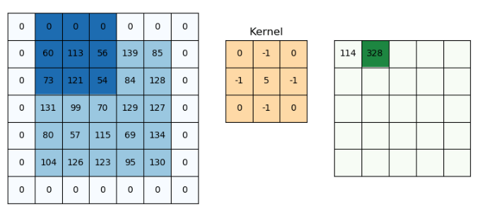
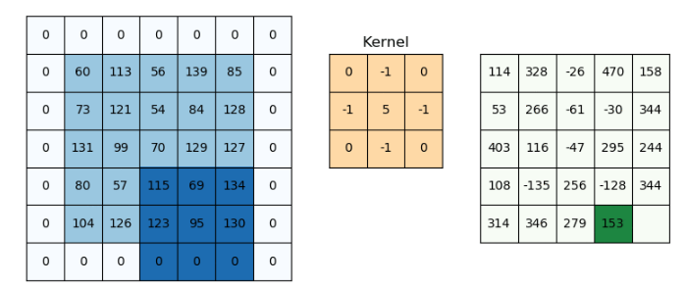
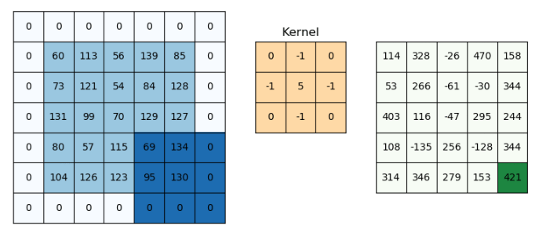

Slide 29
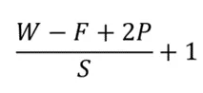
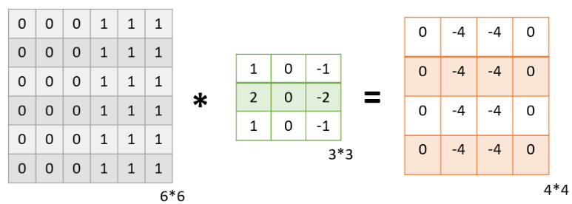
Convolution Layer
The convolution layer is the layer where the filter is applied to our input image to extract or detect its features.
A filter is applied to the image multiple times and creates a feature map.
we will take a 2D input image with normalized pixels.

Slide 30
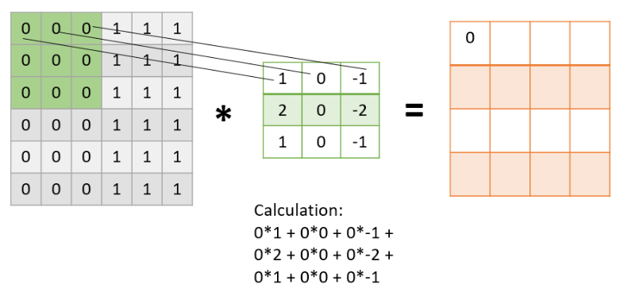
Let’s get into some maths behind getting the feature map in the above image.

Slide 31
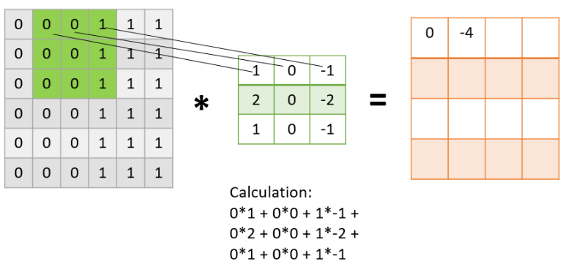
With stride
In the next step, the filter is shifted by one column.
This jump to the next column or row is known as stride .
we are taking a stride of 1 which means we are shifting by one column.
Similarly, the filter passes over the entire image and we get our final Feature Map. Once we get the feature map, an activation function is applied to it for introducing nonlinearity.
A point to note here is that the Feature map we get is smaller than the size of our image. As we increase the value of stride the size of the feature map decreases.

Slide 32
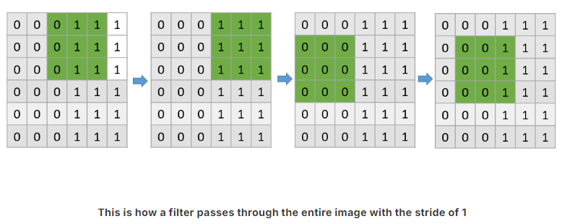
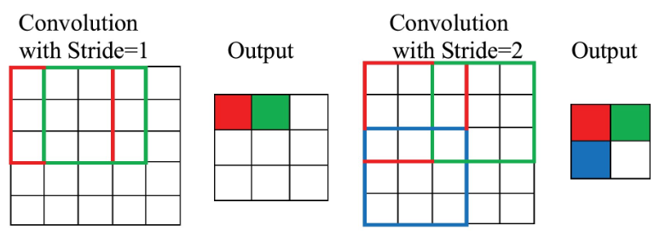

Slide 33
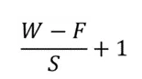
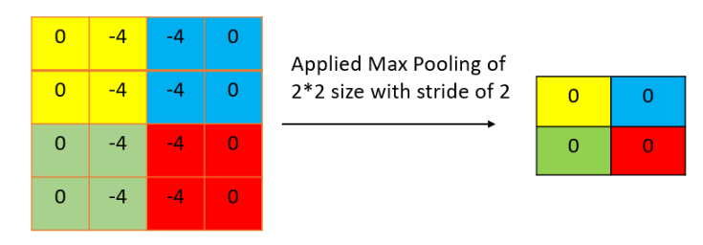
Pooling Layer
The pooling layer is applied after the Convolutional layer and is used to reduce the dimensions of the feature map which helps in preserving the important information or features of the input image and reduces the computation time.

Slide 34
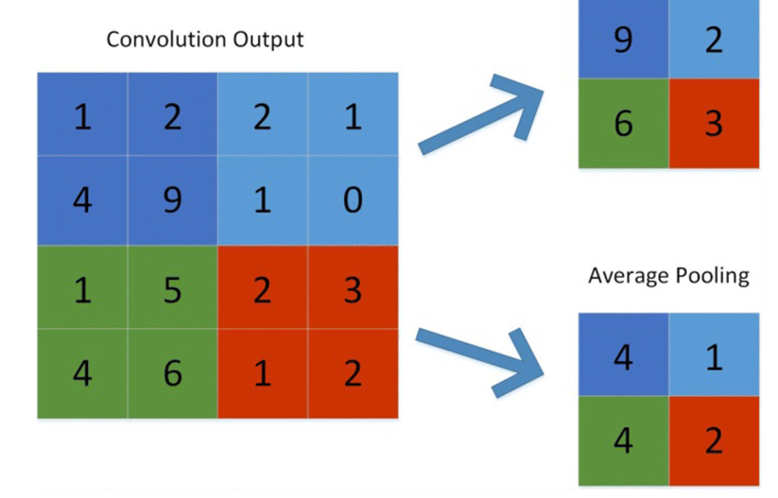
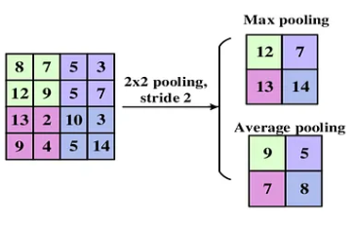
Pooling
The following are some methods for pooling:
Min Pooling: It chooses the least significant element from the feature map. (used when image has lighter background)
Max-pooling: It chooses the most significant element from the feature map. The feature map’s significant features are stored in the resulting max-pooled layer. It is the most popular method since it produces the best outcomes. (used when image has dark background)
Average pooling: It entails calculating the average for each region of the feature map.

Slide 35
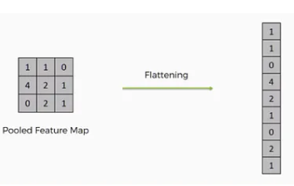
Flatten
Flattening is used to convert all the resultant 2-Dimensional arrays from pooled feature maps into a single long continuous linear vector.
The flattened matrix is fed as input to the fully connected layer to classify the image.

Slide 36
Fully Connected Layer
The Fully connected layer (as we have in ANN) is used for classifying the input image into a label.
This layer connects the information extracted from the previous steps (i.e Convolution layer and Pooling layers) to the output layer and eventually classifies the input into the desired label.

Slide 37
Layers used to build CNN
Convolutional neural networks are distinguished from other neural networks by their superior performance with image, speech, or audio signal inputs. They have three main types of layers, which are:
Convolutional layer
Pooling layer
Fully-connected (FC) layer
Convolutional layer
This layer is the first layer that is used to extract the various features from the input images. In this layer, We use a filter or Kernel method to extract features from the input image.
Pooling layer
The primary aim of this layer is to decrease the size of the convolved feature map to reduce computational costs. This is performed by decreasing the connections between layers and independently operating on each feature map. Depending upon the method used, there are several types of Pooling operations. We have Max pooling and average pooling.
Fully-connected layer
The Fully Connected (FC) layer consists of the weights and biases along with the neurons and is used to connect the neurons between two different layers. These layers are usually placed before the output layer and form the last few layers of a CNN Architecture.

Slide 38
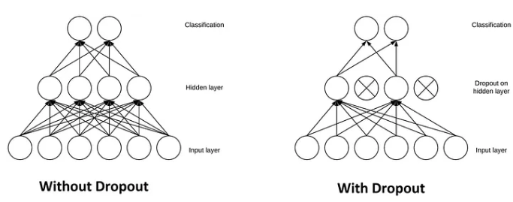
Dropout
Another typical characteristic of CNNs is a Dropout layer. The Dropout layer is a mask that nullifies the contribution of some neurons towards the next layer and leaves unmodified all others.

Slide 39
Activation Function
An Activation Function decides whether a neuron should be activated or not. This means that it will decide whether the neuron’s input to the network is important or not in the process of prediction. There are several commonly used activation functions such as the ReLU, Softmax, tanH, and the Sigmoid functions.
Sigmoid — For a binary classification in the CNN model
tanH - The tanh function is very similar to the sigmoid function. The only difference is that it is symmetric around the origin. The range of values, in this case, is from -1 to 1.
Softmax- It is used in multinomial logistic regression and is often used as the last activation function of a neural network to normalize the output of a network to a probability distribution over predicted output classes.
RelU- the main advantage of using the ReLU function over other activation functions is that it does not activate all the neurons at the same time.

Slide 40
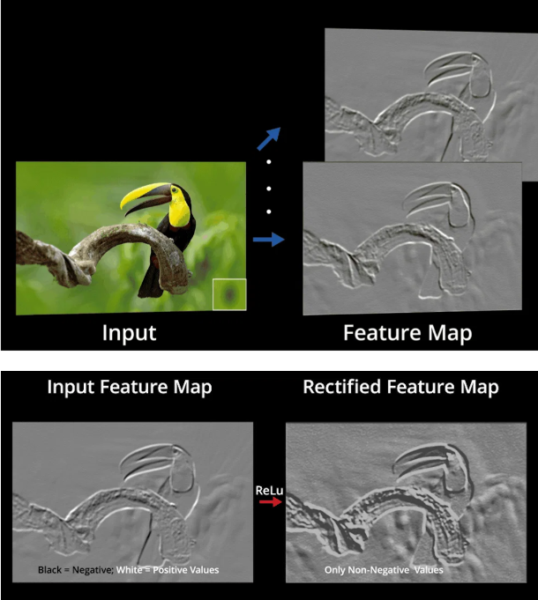

Slide 41
subsampling
Reducing the larger images to smaller images (compressing).
Subsampling images will not change the object, even after reducing the high dimensionality images to low dimensions.
In cnn, images should not be vectorized, should be handled or taken as image itself.

Slide 42
Convolutional Neural Networks (CNNs) have an input layer, an output layer, numerous hidden layers, and millions of parameters, allowing them to learn complicated objects and patterns. It uses convolution and pooling processes to sub-sample the given input before applying an activation function, where all of them are hidden layers that are partially connected, with the completely connected layer at the end resulting in the output layer. The output shape is similar to the size of the input image.
Convolution is the process of combining two functions to produce the output of the other function. The input image is convoluted with the application of filters in CNNs, resulting in a Feature map. Filters are weights and biases that are randomly generated vectors in the network. Instead of having individual weights and biases for each neuron, CNN uses the same weights and biases for all neurons. Many filters can be created, each of which catches a different aspect from the input. Kernels are another name for filters.

Slide 43
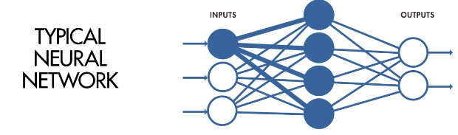
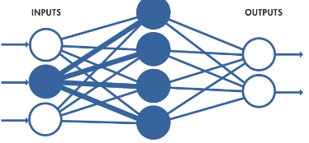
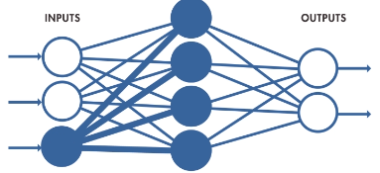
3 keys concepts of CNN
Local receptive fields
Shared weights and biases
Activation and pooling
In typical NN, each neuron in input layer is connected with the neurons in hidden layer as given below

Slide 44
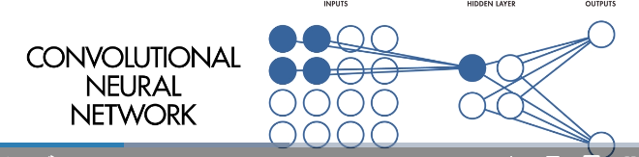
local receptive fields
Only small neurons of input connected to neurons in hidden layer. These regions are referred to as local receptive fields.
These fields are used to transfer the input to feature maps

Slide 45
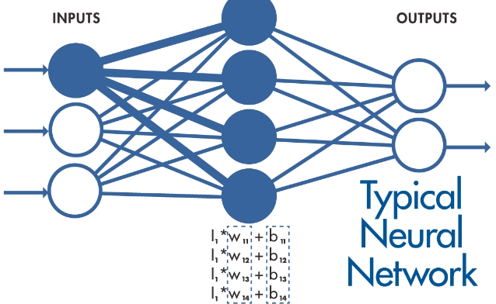
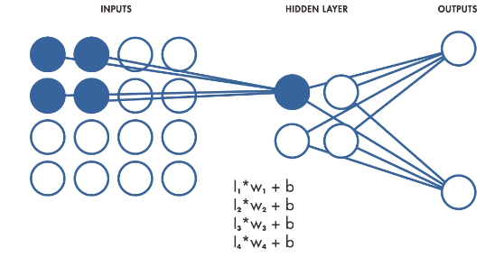
Shared weights
In typical NN, each neurons with weights and bias.(different weights for each neurons)
However, incase of CNN, weights and bias are same for all hidden neurons

Slide 46
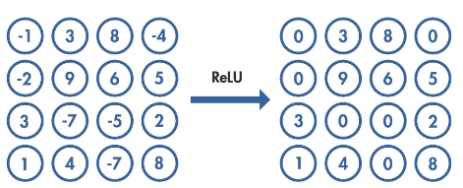
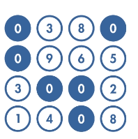
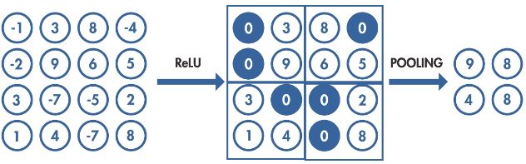
Activation and pooling
Takes the output of the neuron and maps it with the highest positive value, if output is negative, the activation function maps it to zero.

Slide 47
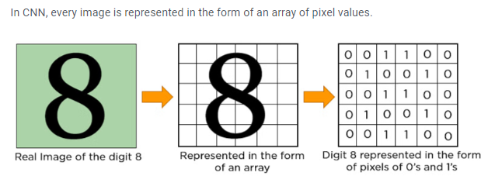
The convolution operation forms the basis of any convolutional neural network. Let’s understand the convolution operation using two matrices, a and b, of 1 dimension.
a = [5,3,7,5,9,7]
b = [1,2,3]
In convolution operation, the arrays are multiplied element-wise, and the product is summed to create a new array, which represents a*b.
The first three elements of the matrix a are multiplied with the elements of matrix b. The product is summed to get the result.

Slide 48
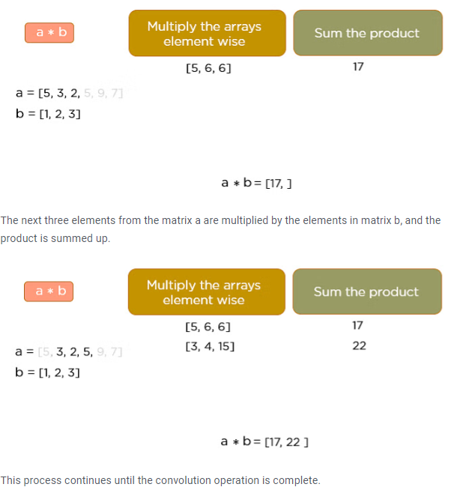

Slide 49


